Slide 1

Imagine it's a year from now… in the future…
Write a postcard to your present self from your future self.
Capture what progress and impact you've made with ZeroWasteNW over the past year.
Fill and send your postcard to us at : info@zerowastenw.org
Duplicate a blank postcard and write away!

Slide 2

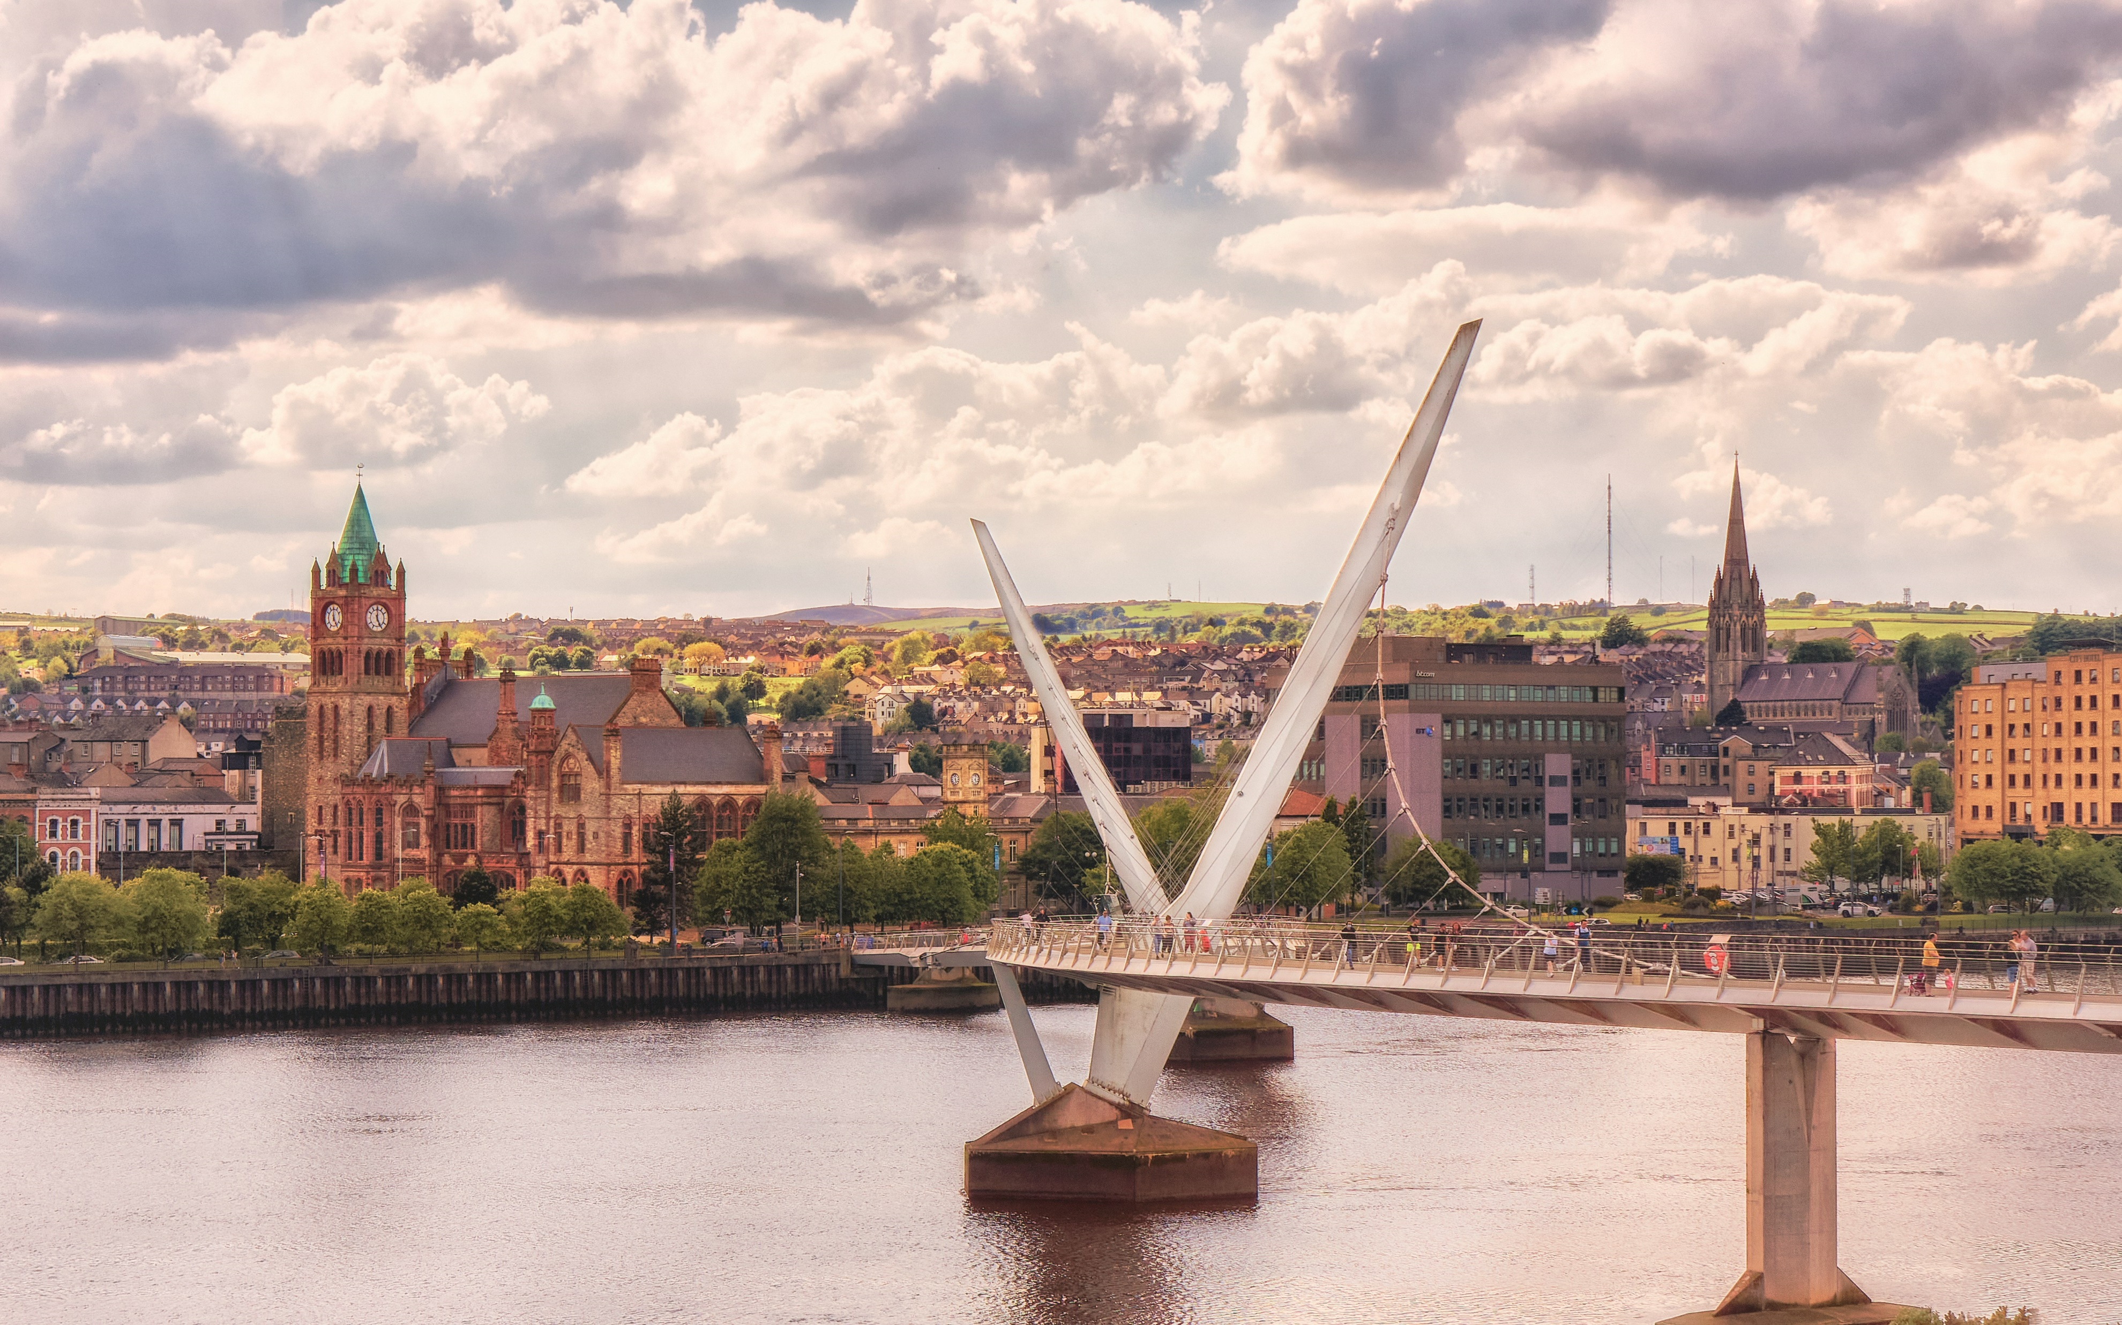
.
Derry
Credit: K. Mitch Hodge, Unsplash

